Slide 1

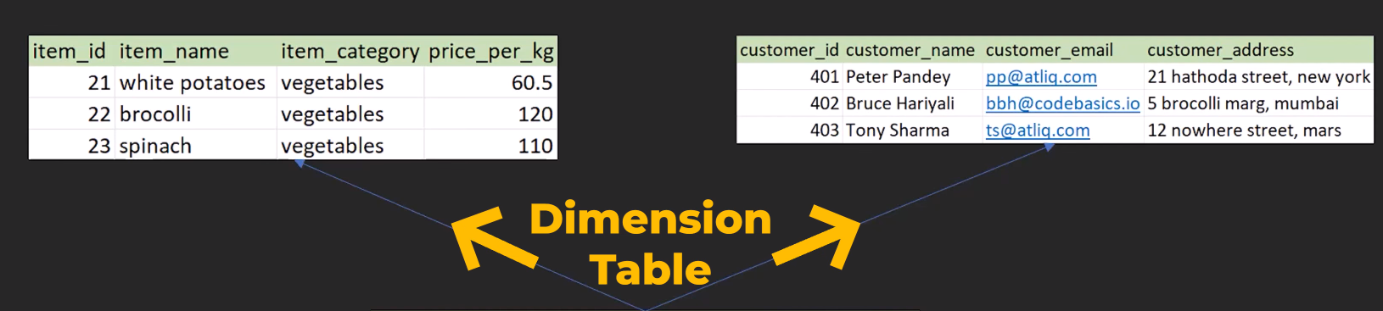
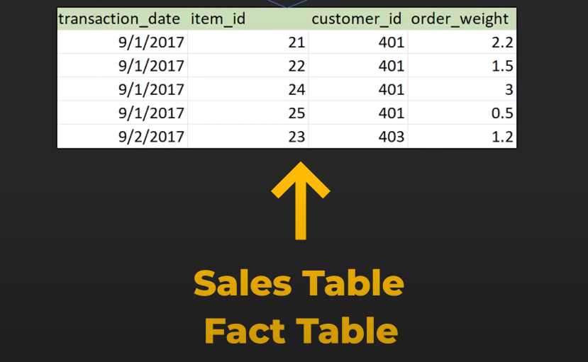
Fact Vs Dimension Table

Slide 2
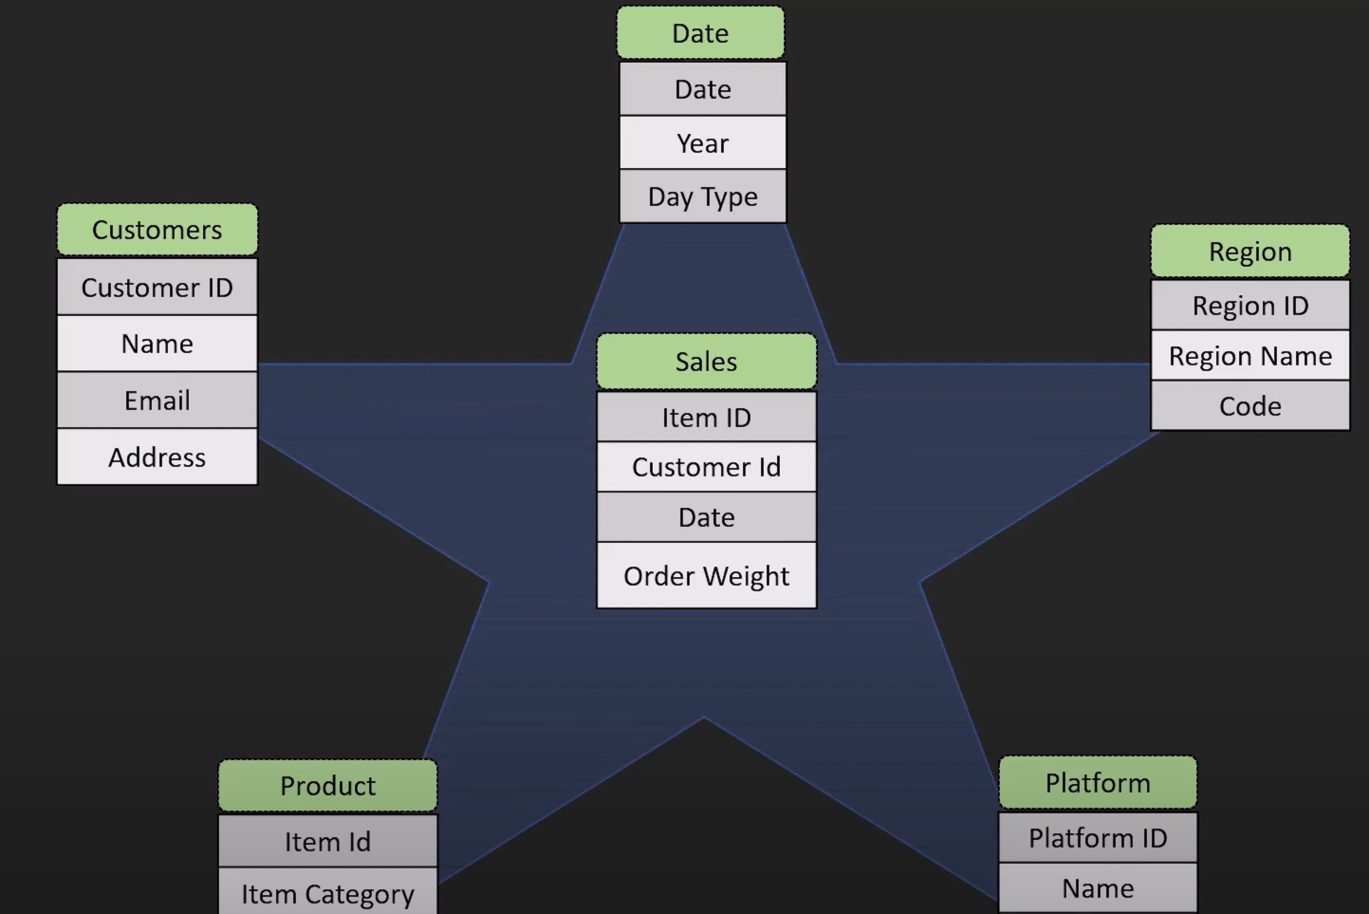
STAR Schema

Slide 3
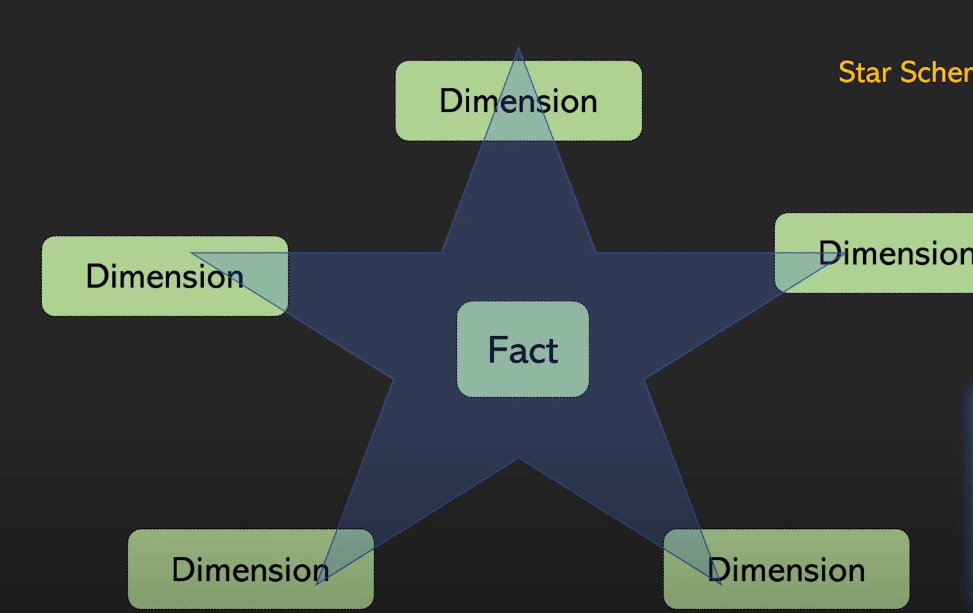
STAR Schema

Slide 4
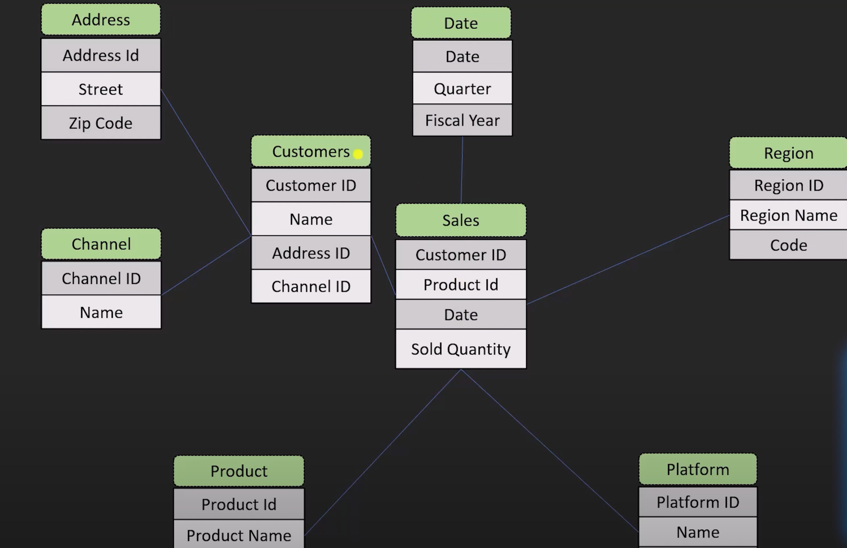
Snowflake Schema

Slide 5
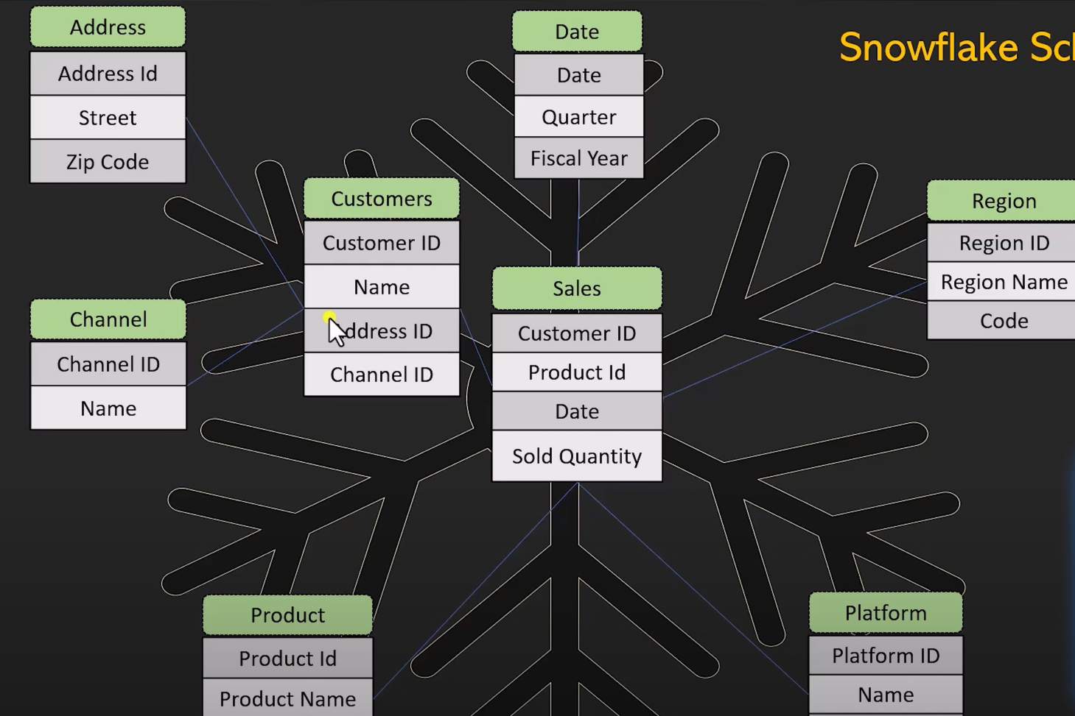
Snowflake Schema

Slide 6
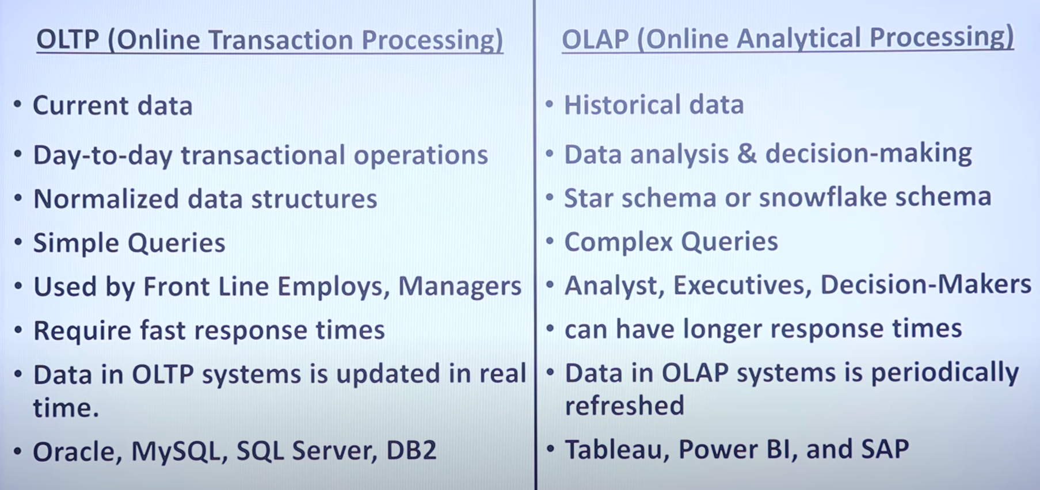
OLAP VS OLTP

Slide 7

OBJECTIVE
To contribute to the success of a business by utilizing data analysis techniques, specially focusing on time series analysis , to provide valuable insights and accurate sales forecasting

Slide 8
DESCRIPTION
The objective can be broken down into the following detailed explanation:
Dashboard Creation: Identify the KPI’s , design an intuitive and visually appealing dashboard , and interactive visualizations and filtering capabilities to allow users to explore the data at various levels of granularity.
Data Analysis: Provide valuable insights to business entities regrading the effectiveness of their sales strategies through visualization and charts.
Sales Forecasting: Leverage historic data and apply time series analysis to generate sales forecasts for next 15 days.
Actionable insights and recommendations: End goal is to share valuable insights and actionable information that can drive strategic decision-making and support the supermarket’s goals for growth , efficiency and customer satisfaction

